Slide 1
Agile Risk Management
Lecturer: Ngo Huy Bien
Software Engineering Department
Faculty of Information Technology
VNUHCM - University of Science
Ho Chi Minh City, Vietnam
nhbien@fit.hcmus.edu.vn

Slide 2

Objectives
To identify project risks
To analyze project risks
To propose and select risk responses
To create risk management plan
To monitor and track project risks

Slide 3

Contents
Risk list
Risk mitigation stories
Risk exposure
Risk contingency stories

Slide 4

References
James Shore and Shane Warden (2008). The Art of Agile Development. O'Reilly.

Slide 5
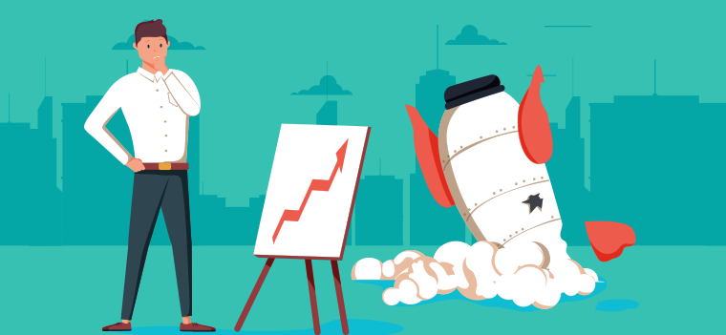
Why Do Projects Fail? [1]
Velocity only reflects the issues the team normally faces. Life always has some additional curve balls to throw.
Team members get sick and take vacations;
Hard drives crash;
Although the backups worked, the restore doesn’t;
New requirements;
Work disruption.

Slide 6
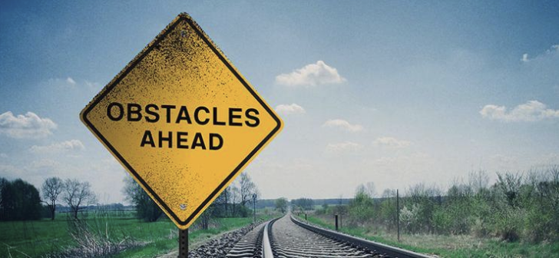
How to Prevent Potential Problems

Slide 7
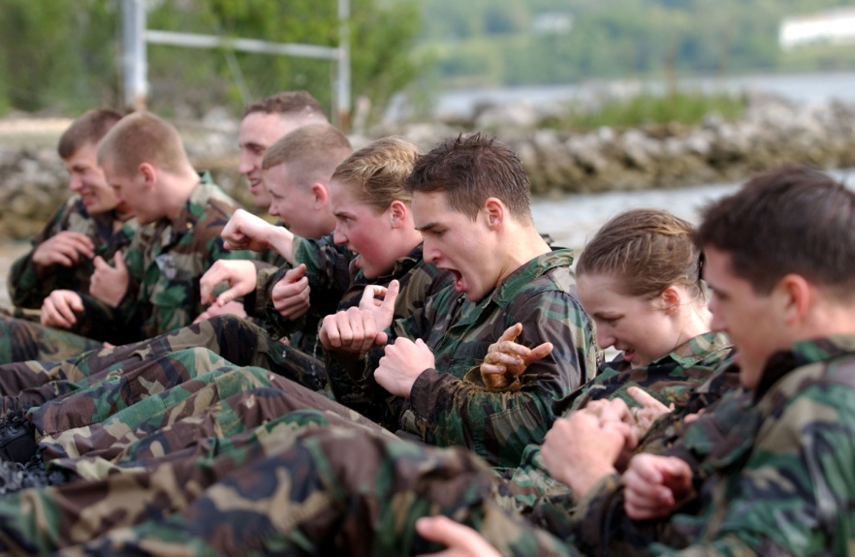
1. Evaluate Your Process Approach
Rigorous process approach
Strictly follow “Definition of Done”,
Stable velocity,
Fix all bugs of previous iteration
Finish other iteration work
Risky process approach

Slide 8
2. Determine Risk Multipliers
In a perfect world, your organization would have a database of the type shown in table below.
Because most organizations don’t have this information available, I’ve provided some generic risk multipliers instead.
Percent chance of on-time completion | Rigorous approach | Risky approach | Description
10% | x1 | x1 | Almost impossible (“ignore”)
50% | x1.4 | x2 | 50-50 chance (“stretch goal”)
90% | x1.8 | x4 | Virtually certain (“commit”)

Slide 9
3. Apply the Risk Multipliers
Process = Rigorous.
Velocity = 14 points.
# Sprints left = 10.
Percent chance of on-time completion | Rigorous approach | Risky approach | Description
10% | x1=140 x = 140 | x1 | Almost impossible (“ignore”)
50% | x1.4=140 x = 100 | x2 | 50-50 chance (“stretch goal”)
90% | x1.8=140 x = 78 | x4 | Virtually certain (“commit”)

Slide 10

4. Brainstorm Project-Specific Risks
What about the project keeps you up at night?
Imagine it’s a year after the project’s disastrous failure and you’re being interviewed about what went wrong. What happened?
Imagine your best dreams for the project, then write down the opposite.
How could the project fail without anyone being at fault?
How could the project fail if it were the stakeholders’ faults? The customers’ faults? Testers? Programmers? Management? Your fault?
How could the project succeed but leave one specific stakeholder unsatisfied or angry?

Slide 11

Challenges in Previous Classes (I)
Team members leaving or losing motivation.
Unclear requirements: Real world problems, domain knowledge.
Availability and cost of reliable AI coding agents.
Earlier releases from competitors.

Slide 12

Challenges in Previous Classes (II)
Not enough time
Working on new technologies
Lack of leadership
No status reporting
Unclear requirements: Real world problems, domain knowledge.

Slide 13
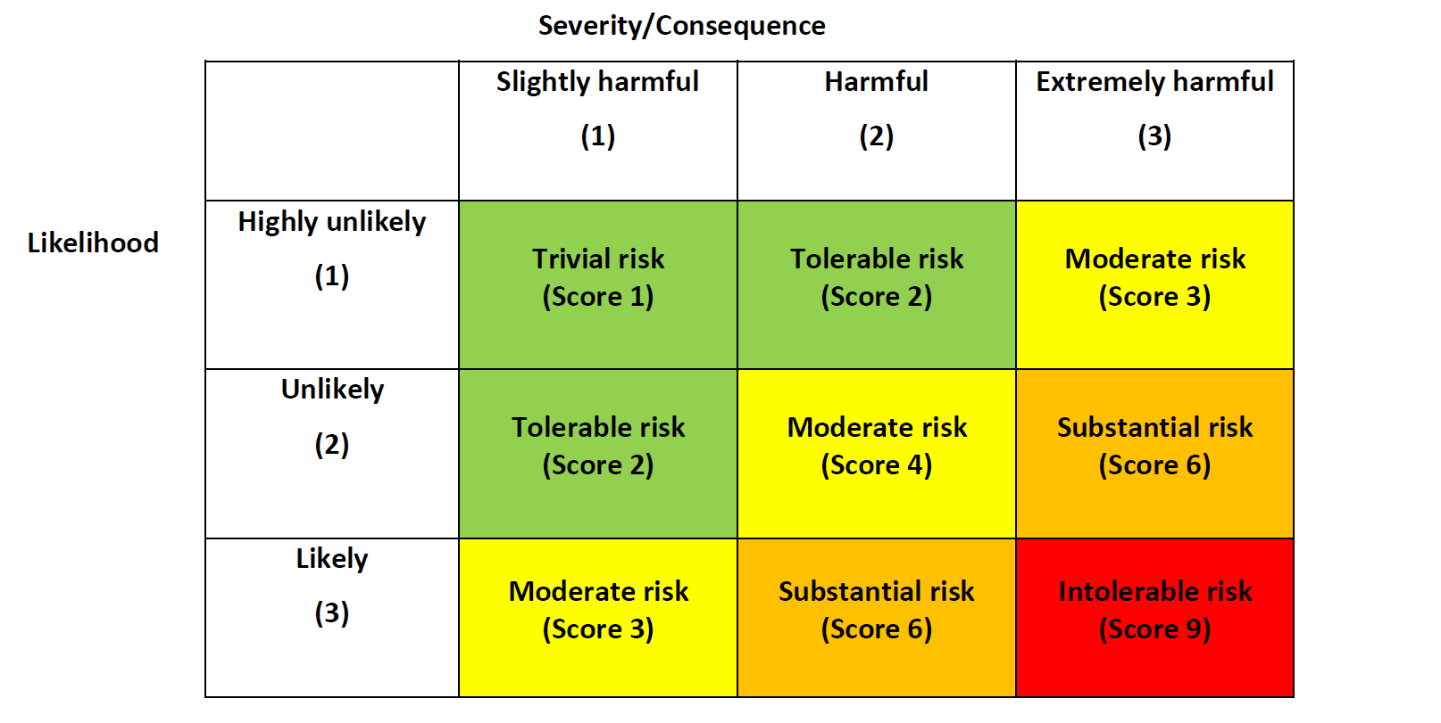
5. Analyze Risks
Consider the risks within a smaller group.
For each risk, determine:
Estimated probability—I prefer “high,” “medium,” and “low.”
Specific impact to project if it occurs—dollars lost, days delayed, and project cancellation are common possibilities.

Slide 14

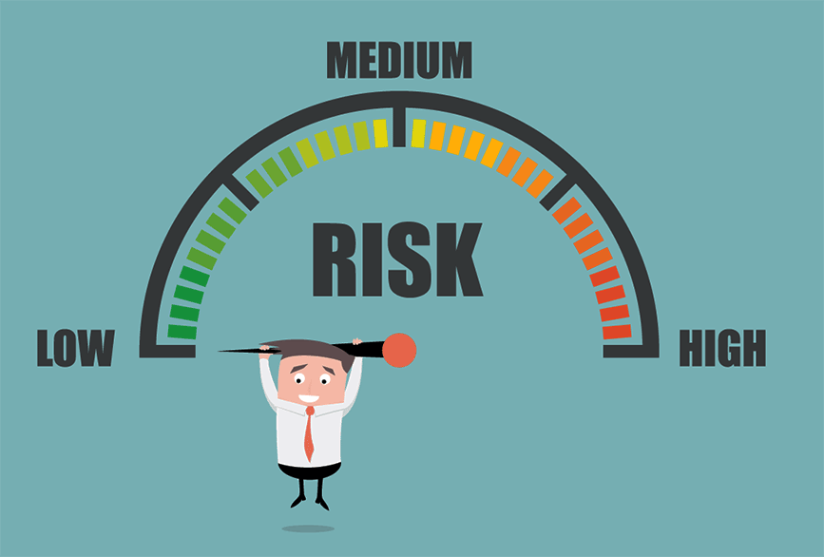
6. Prioritize Risks

Slide 15

7. Respond to a Risk
Avoid the risk by not taking the risky action;
Contain it by reserving extra time or money, as with the risk multiplier;
Mitigate it by taking steps to reduce its impact.
You can combine these actions.

Slide 16

7. Respond to a Risk (II)
Determine transition indicators, mitigation and contingency activities, and your risk exposure.
Transition indicators tell you when the risk will come true.
Mitigation activities reduce the impact of the risk. Create stories for them and add them to your release plan.
Contingency activities also reduce the impact of the risk, but they are only necessary if the risk occurs.
Risk exposure reflects how much time or money you should set aside to contain the risk.

Slide 17
Example
Not enough time
?
?
Working on new technologies
?
Lack of leadership
?
Unclear requirements
?
?

Slide 18

Thank You & See You Again

